Slide 1



Slide 2
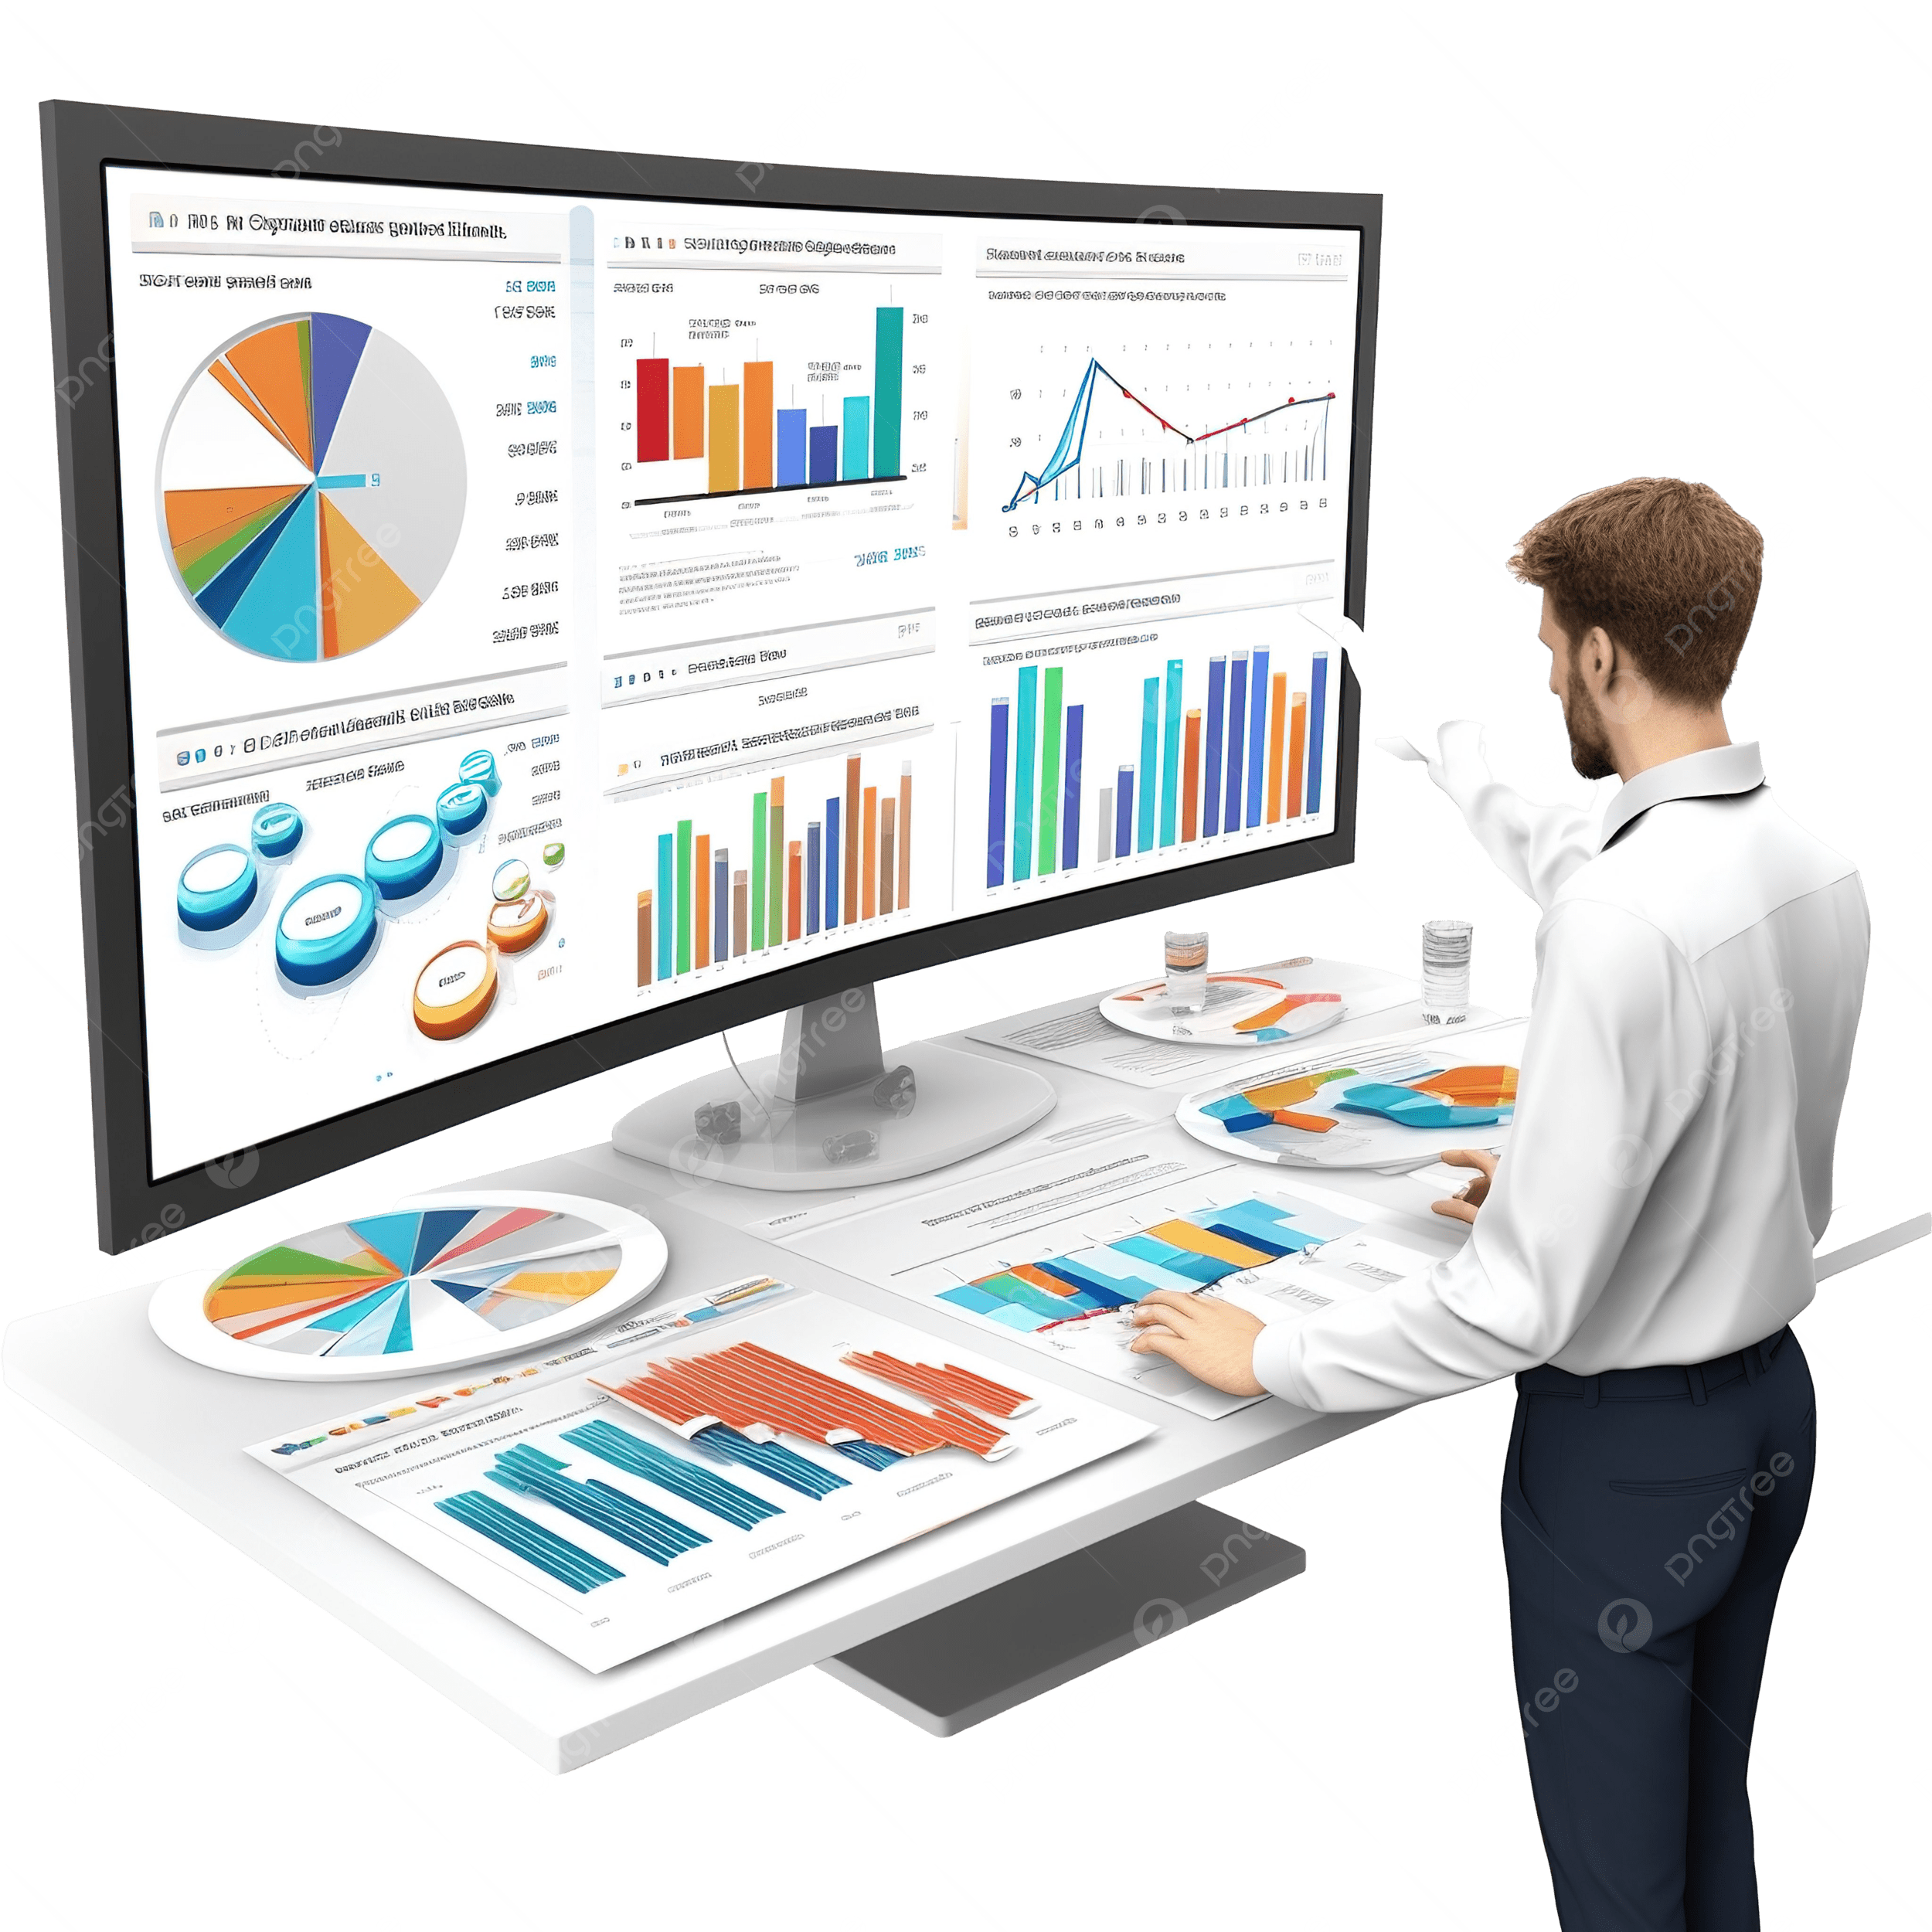
BUSINESS ANALYTICS Introduction to Business Analytics and Core Business Functions
BUSINESS ANALYSIS Data Visualization

Slide 3
Learning Objectives – WEEK 11
By the end of today you should be able to:
Understand why visualization is critical in business
Choose the right chart for the right data
Design simple dashboards
Avoid common visualization mistakes
Think like a Business Analyst when presenting data
A bad chart hides the truth. A good chart tells a story instantly.

Slide 4
Previous Week - 10
Last week we defined KPIs:
✔ Revenue ✔ Delivery time ✔ Customer retention
Now :
👉 How do we show this to stakeholders?
Answer:
👉 Through data visualization (charts, dashboards)
Example:
KPI:
Delivery time = 45 min
Question:
👉 Is that good or bad?
Now show chart → students understand instantly.

Slide 5
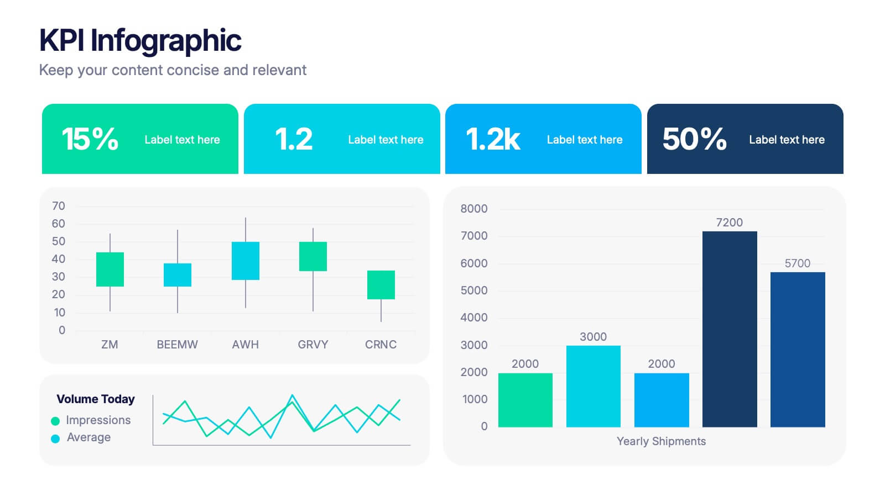
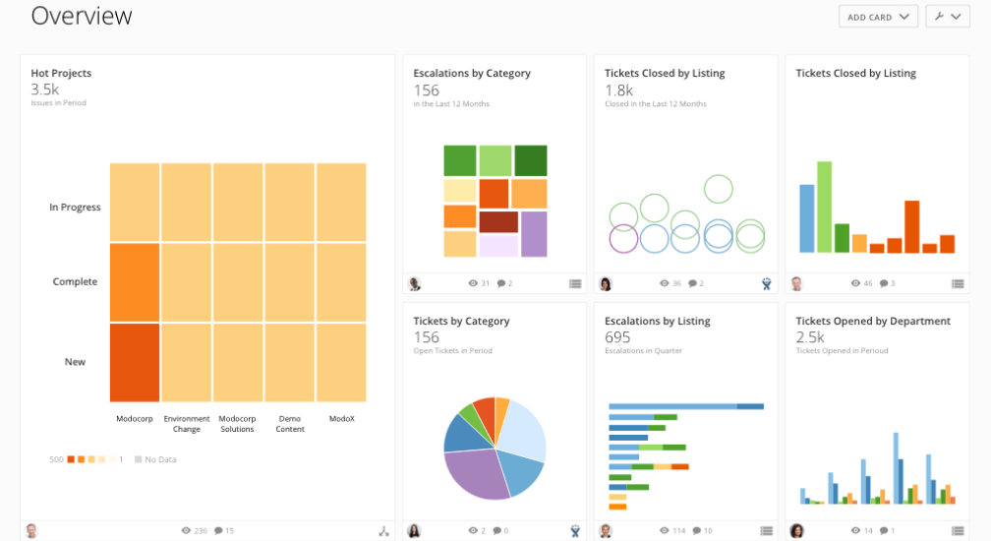
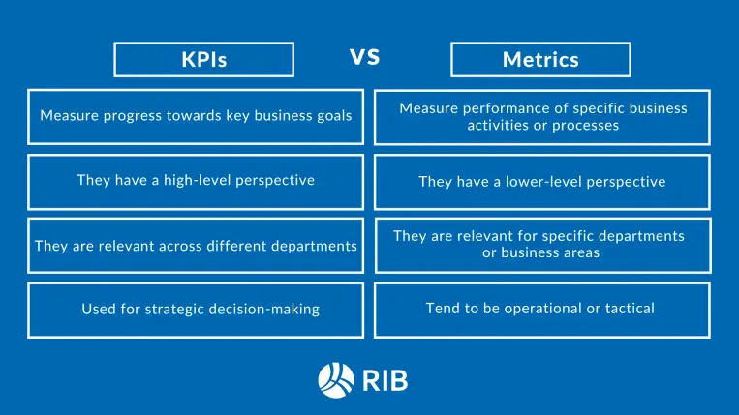
WHAT IS DATA VISUALIZATION?
Data Visualization = presenting data visually to make decisions easier.
🇵🇰 Pakistan Example
Daraz dashboard:
Orders per day
Delivery performance
Revenue trends
🌎 International Example
Netflix dashboard:
Watch time
User engagement
Retention trends
Overlay:
Data → Chart → Insight → Decision
Ask:
👉 “Would you rather read 100 rows of Excel OR see one chart?”

Slide 6
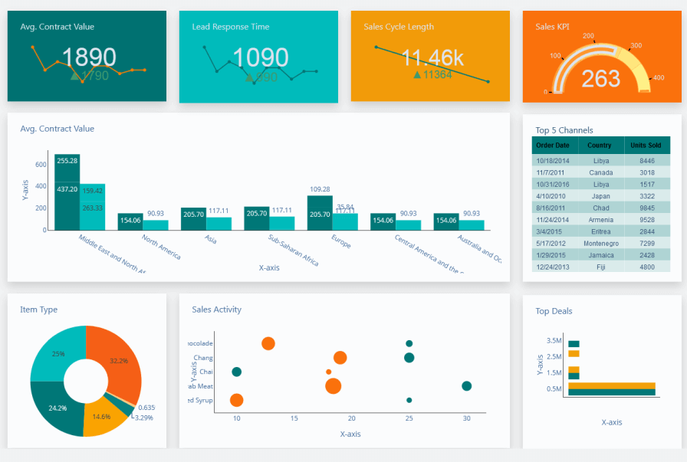
WHY VISUALIZATION MATTERS (INDUSTRY REALITY)
Without visualization:
❌ Data is hard to interpret ❌ Decisions delayed ❌ Stakeholders confused
With visualization:
✔ Quick understanding ✔ Better decisions ✔ Clear communication
KPI → Chart → Dashboard → Decision
Executives don’t read data tables — they read dashboards.

Slide 7
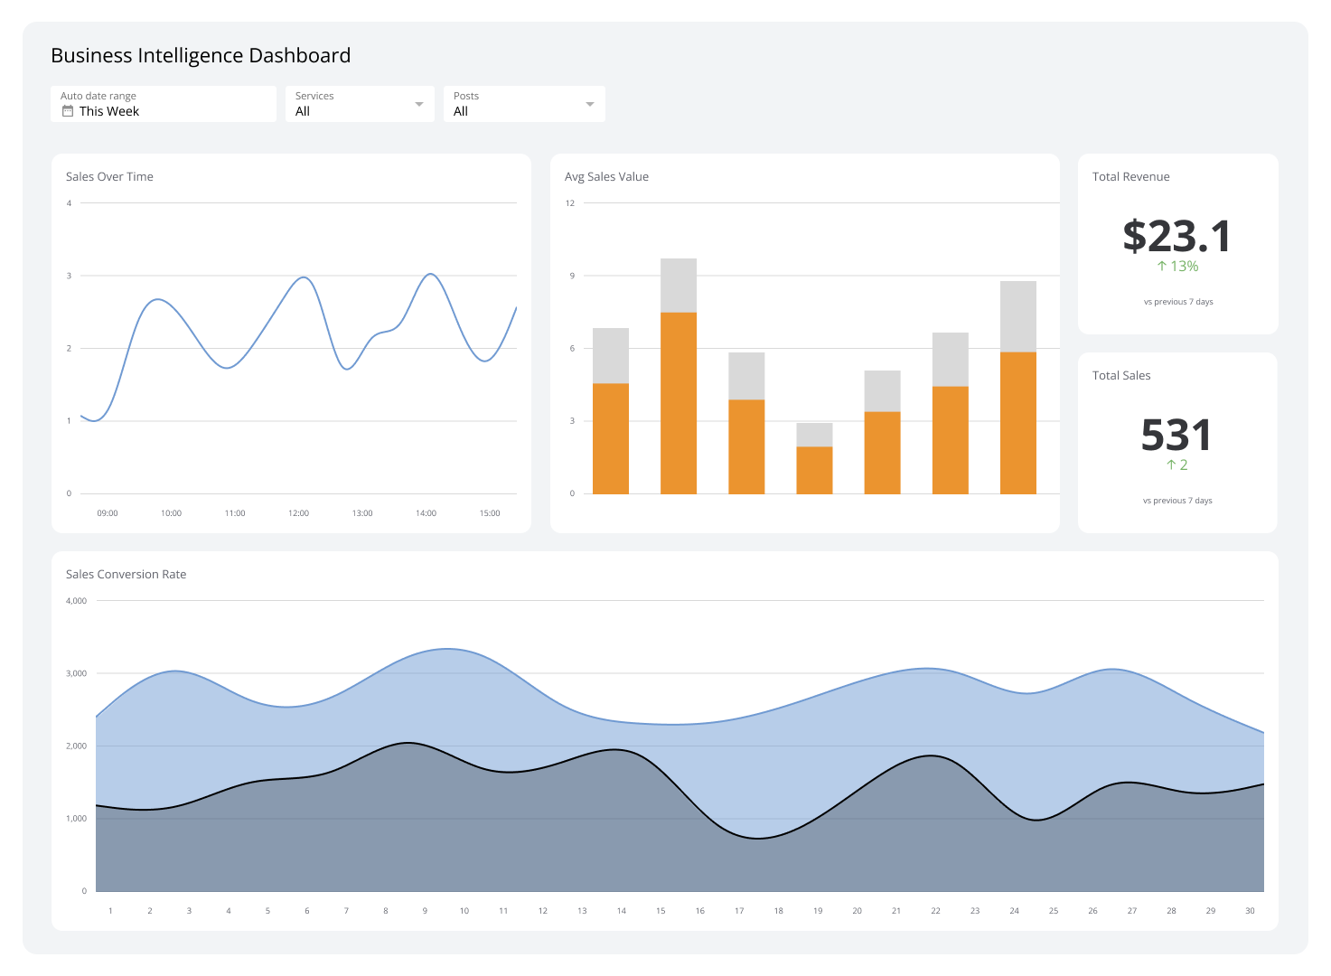
TYPES OF CHARTS
📈 Line Chart (Trend Over Time)
Use when:
✔ Showing growth or decline
Example:
Daraz orders over 6 months.
Bar Chart (Comparison)
Use when:
✔ Comparing categories
Example:
Sales by city (Lahore vs Karachi)

Slide 8
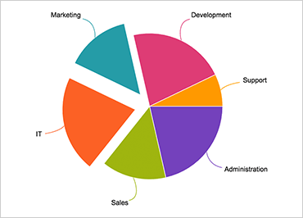
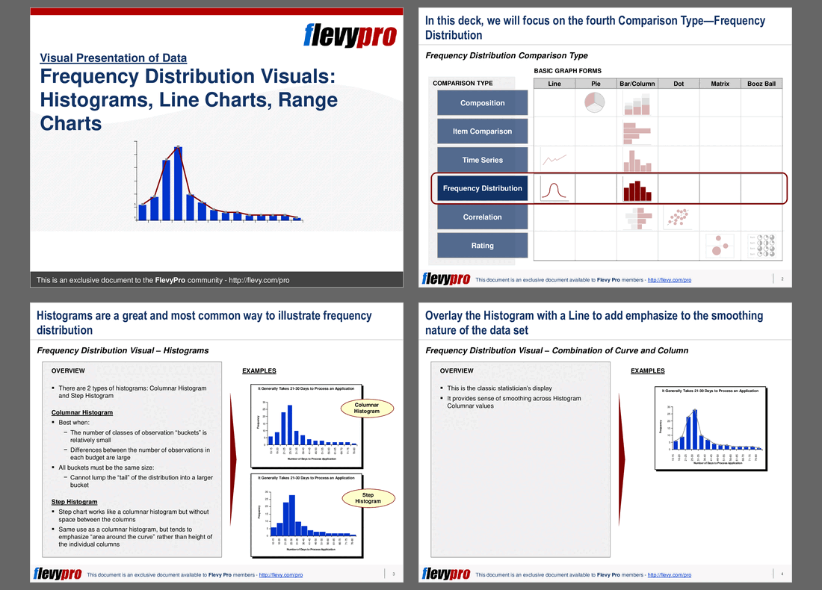
TYPES OF CHARTS
Pie Chart (Distribution)
Use when:
✔ Showing proportions
Example:
Payment types (Cash vs Card)
⚠️ Warning:
Avoid too many slices.
📉 Histogram (Distribution)
Use when:
✔ Understanding frequency
Example:
Delivery times grouped (20–30 mins, 30–40 mins)

Slide 9
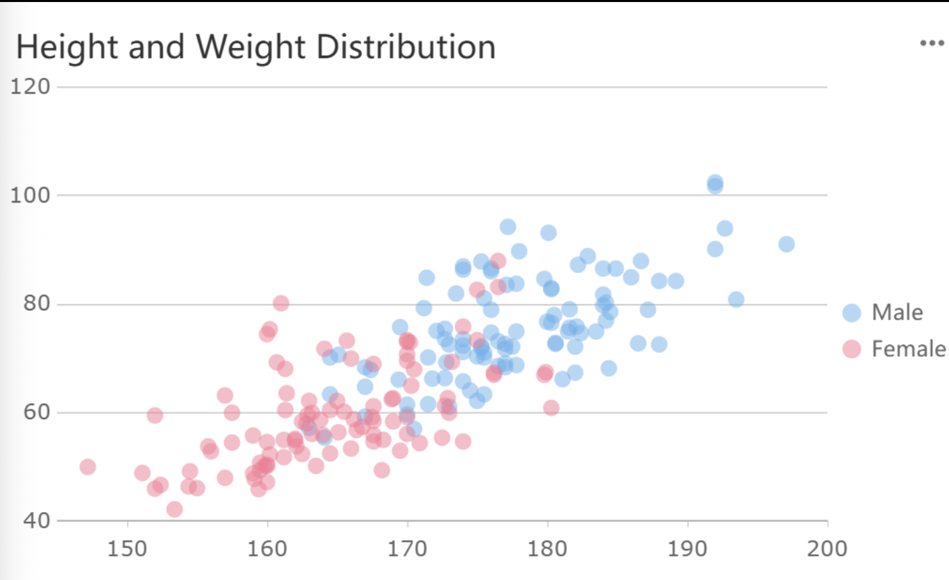
TYPES OF CHARTS
📍 Scatter Plot (Relationship)
Use when:
✔ Finding correlation
Example:
Delivery time vs customer rating
Ask students:
👉 Which chart for:
“Revenue over time?”
👉 Which chart for:
“Top 5 cities by orders?”

Slide 10
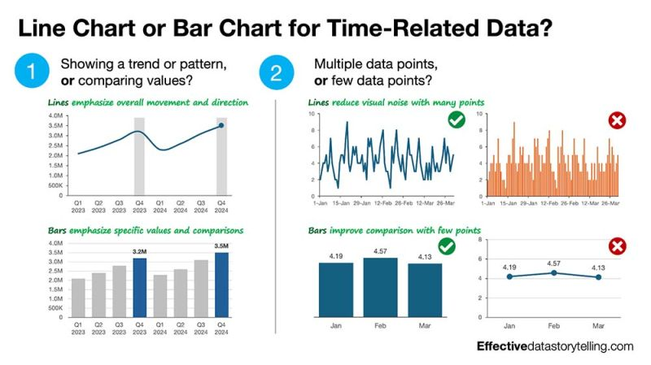
VISUALIZATION PRINCIPLES
1️⃣ Keep it Simple
Avoid clutter.
2️⃣ Use Correct Chart
Don’t use pie chart for trends.
3️⃣ Highlight Insights
Use color to show important data.
4️⃣ Label Clearly
No confusion in axes or titles.
5️⃣ Avoid Misleading Data
Don’t distort scales.

Slide 11
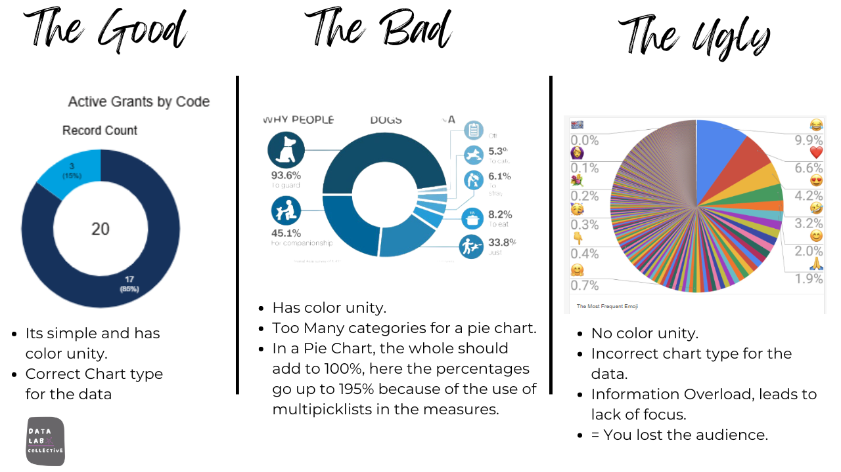
VISUALIZATION PRINCIPLES
Example
Show bad chart:
Too many colors
No labels
Then show improved
version.

Slide 12
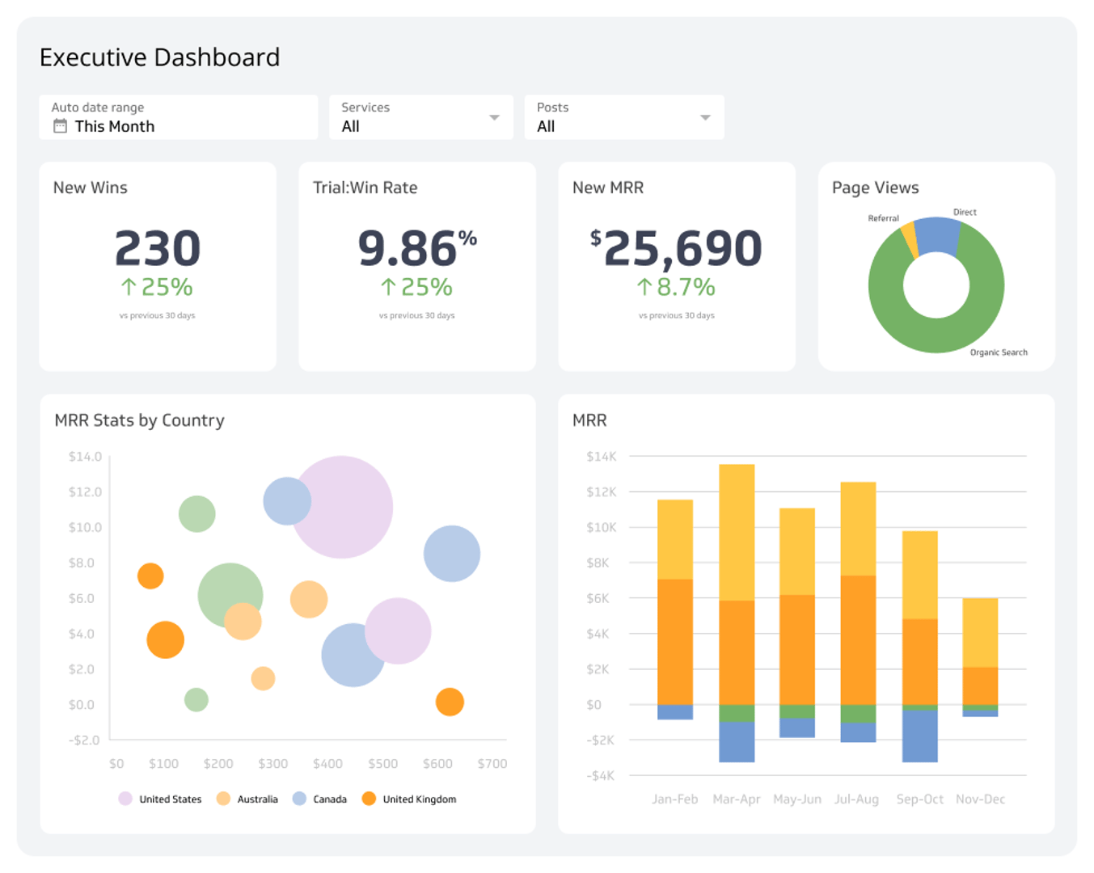
DASHBOARD DESIGN
Dashboard = collection of charts showing KPIs.
Example — QuickBasket Dashboard
Include:
✔ Orders per day ✔ Delivery time ✔ Customer complaints ✔ Revenue
Layout Tip
Top → KPIs Middle → Trends Bottom → Details

Slide 13
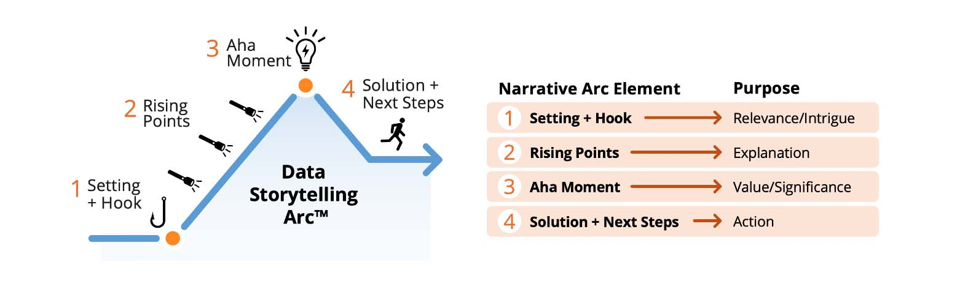
STORYTELLING WITH DATA
Explain:
Charts alone are not enough.
BA must explain:
✔ What is happening ✔ Why it matters ✔ What action to take
Example
Chart shows:
Delivery time increasing.
BA says:
👉 “Delays increased by 20% due to manual assignment — recommend automation.”
Data + Story = Decision.

Slide 14
COMMON VISUALIZATION MISTAKES
❌ Too many charts ❌ Wrong chart type ❌ No context ❌ Overuse of colors ❌ Ignoring audience
Bad dashboards confuse stakeholders.

Slide 15
TOOLS INTRODUCTION – NEXT CLASS | PRACTICAL IMPLEMENTATION
🟢 Excel
Basic charts Good for beginners
🔵 Power BI
Interactive dashboards Used in industry
🟣 Tableau
Advanced visualization Used globally
You don’t need tool mastery — focus on thinking.

Slide 16
KEY TAKEAWAYS (END OF LECTURE)
✔ Visualization simplifies complex data ✔ Right chart = correct understanding ✔ Dashboards drive decisions ✔ BA role = interpret + communicate
“Many dashboards fail because they show data, not insight.”
“A chart without explanation is just decoration.”
“Executives don’t need more data — they need clarity.”
👉 “Where does a Business Analyst add value?”
Answer:
👉 Insight + Decision
Notes:
“Visualization turns data into understanding.”
Repeat:
Visualization simplifies complexity
Right chart = correct insight
Dashboards support decisions
BA interprets and communicates

